Slide 1

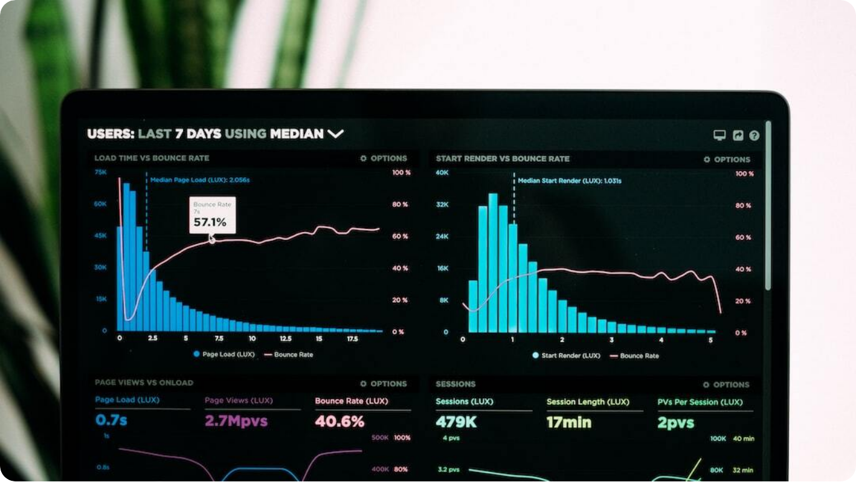
Python for Data Science
Day 1 – Introduction & Fundamentals
Chandramouli Das : Sr Data Scientist
Organized by: GUVI | HCL
Course Focus: From Python basics to building real-world data applications
Interactive Sessions: Hands-on practice, Q&A, and mini-projects daily
Photo by Luke Chesser on Unsplash
Notes:
Welcome to the exciting world of Python for Data Science! I’m [Your Name], your trainer for this journey. As a Senior Data Scientist, my goal is to guide you from foundational programming skills to building intelligent, data-driven applications.
This course is hosted by GUVI and HCL and is designed to balance structured learning with interactive, hands-on experience. You'll engage with real code, solve practical problems, and get your hands dirty with Python.
Let’s make this an engaging and impactful learning experience. Be ready to code, ask questions, and think like a data scientist. Let's get started!

Slide 2
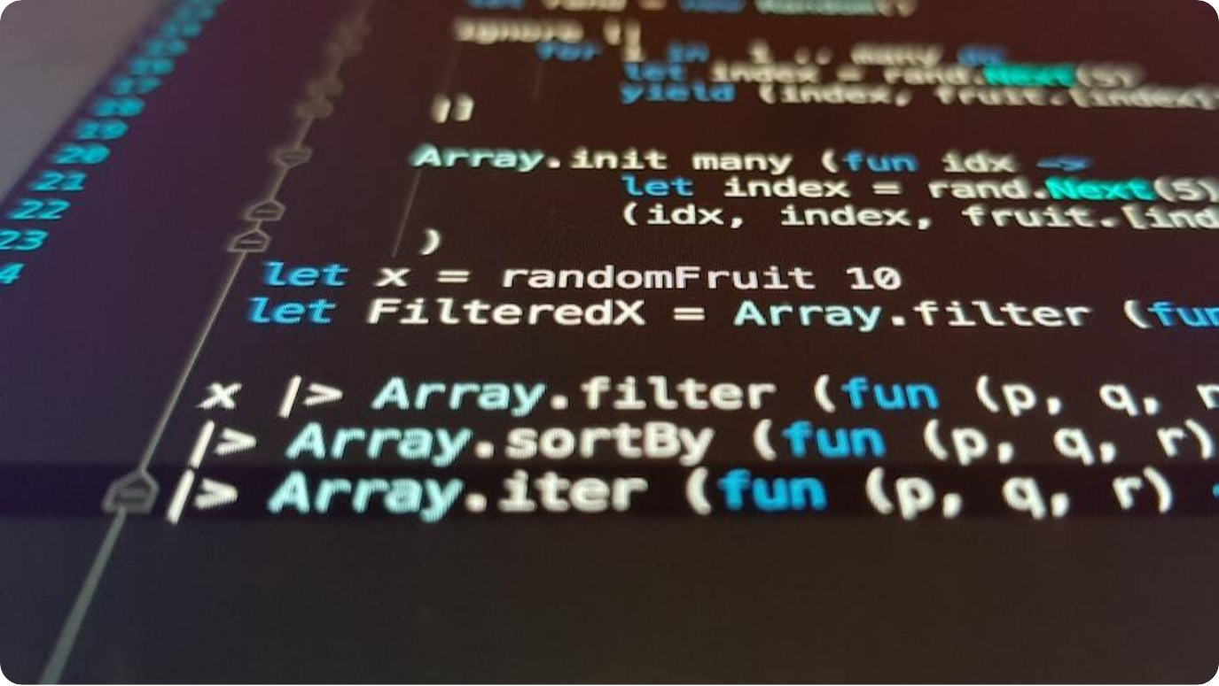
Why Learn Python for Data Science?
The Dominance of Python in the Data Ecosystem
Widely Adopted: Python is the most used language in data science due to its simplicity and community support.
Extensive Libraries: Includes powerful libraries like Pandas, NumPy, Scikit-learn, Matplotlib, and TensorFlow.
Versatility: From data wrangling to machine learning, Python covers all stages of the data pipeline.
Industry Standard: Top companies like Google, Netflix, and Spotify use Python extensively in their data workflows.
Photo by Ilija Boshkov on Unsplash
Notes:
Why is Python the language of choice for data scientists across the globe? The answer lies in its ease of use, expansive ecosystem, and sheer versatility. Python has risen to become the most widely adopted language in the data science world. With readable syntax and a low learning curve, it's ideal for both beginners and experienced developers.
A huge advantage of Python lies in its libraries. Whether you're cleaning data with Pandas, analyzing arrays with NumPy, or visualizing trends with Matplotlib—Python has you covered. Need to build machine learning models? Libraries like Scikit-learn and TensorFlow are industry favorites.
Python isn't just a tool; it's a bridge that connects business problems to technical solutions. That’s why data-driven giants like Google, Netflix, and Spotify trust Python at the core of their operations. Let’s dive deeper into how Python empowers your journey in data science.

Slide 3
Why Learn Python for Data Science?
The Dominance of Python in the Data Ecosystem
• Netflix: Movie recommendation using collaborative filtering. • Uber: Predicting estimated time of arrival and dynamic pricing. • Amazon: Product recommendations and inventory optimization. • Healthcare: Predicting disease likelihood based on patient data. • Finance: Detecting fraud in real-time transactions.
Notes:
Why is Python the language of choice for data scientists across the globe? The answer lies in its ease of use, expansive ecosystem, and sheer versatility. Python has risen to become the most widely adopted language in the data science world. With readable syntax and a low learning curve, it's ideal for both beginners and experienced developers.
A huge advantage of Python lies in its libraries. Whether you're cleaning data with Pandas, analyzing arrays with NumPy, or visualizing trends with Matplotlib—Python has you covered. Need to build machine learning models? Libraries like Scikit-learn and TensorFlow are industry favorites.
Python isn't just a tool; it's a bridge that connects business problems to technical solutions. That’s why data-driven giants like Google, Netflix, and Spotify trust Python at the core of their operations. Let’s dive deeper into how Python empowers your journey in data science.

Slide 4
Why Learn Python for Data Science?
The Dominance of Python in the Data Ecosystem
Data Analyst: Visualizes and interprets data to answer business questions.
- Data Scientist: Builds models to predict or classify based on historical data.
- Machine Learning Engineer: Builds and deploys predictive systems at scale.
- Data Engineer: Designs systems for data ingestion, storage, and transformation.
Photo by Ilija Boshkov on Unsplash
Notes:
Why is Python the language of choice for data scientists across the globe? The answer lies in its ease of use, expansive ecosystem, and sheer versatility. Python has risen to become the most widely adopted language in the data science world. With readable syntax and a low learning curve, it's ideal for both beginners and experienced developers.
A huge advantage of Python lies in its libraries. Whether you're cleaning data with Pandas, analyzing arrays with NumPy, or visualizing trends with Matplotlib—Python has you covered. Need to build machine learning models? Libraries like Scikit-learn and TensorFlow are industry favorites.
Python isn't just a tool; it's a bridge that connects business problems to technical solutions. That’s why data-driven giants like Google, Netflix, and Spotify trust Python at the core of their operations. Let’s dive deeper into how Python empowers your journey in data science.

Slide 5
Why Learn Python for Data Science?
The Dominance of Python in the Data Ecosystem
Data Science Lifecycle
The typical steps involved in solving a data science problem: 1. Define the Problem 2. Collect Data 3. Clean and Prepare Data 4. Explore the Data (EDA) 5. Build Model(s) 6. Evaluate Models 7. Deploy the Solution 8. Monitor and Improve
Notes:
Why is Python the language of choice for data scientists across the globe? The answer lies in its ease of use, expansive ecosystem, and sheer versatility. Python has risen to become the most widely adopted language in the data science world. With readable syntax and a low learning curve, it's ideal for both beginners and experienced developers.
A huge advantage of Python lies in its libraries. Whether you're cleaning data with Pandas, analyzing arrays with NumPy, or visualizing trends with Matplotlib—Python has you covered. Need to build machine learning models? Libraries like Scikit-learn and TensorFlow are industry favorites.
Python isn't just a tool; it's a bridge that connects business problems to technical solutions. That’s why data-driven giants like Google, Netflix, and Spotify trust Python at the core of their operations. Let’s dive deeper into how Python empowers your journey in data science.

Slide 6

Setting Up the Environment
Getting Started with Jupyter, Google Colab, and Anaconda
Jupyter Notebooks: Local development tool for writing and executing Python code interactively.
Google Colab: Cloud-based Python execution environment requiring no local setup.
Anaconda Distribution: Comprehensive package that includes Python, Jupyter, and libraries for data science.
Installation Steps: We will walk through installation and configuration of each platform for seamless usage.
Photo by Thought Catalog on Unsplash
Notes:
To begin our Python journey, we need the right tools. This session introduces three essential platforms: Jupyter Notebooks, Google Colab, and Anaconda. Each serves a purpose in making your data science workflow more efficient.
Jupyter Notebooks allow interactive coding, visualizations, and documentation all in one place—ideal for exploring data and prototyping models. Google Colab, on the other hand, runs in the cloud and eliminates the need for local installations, making it a favorite for quick demos and collaborative coding.
Anaconda Distribution bundles everything you need, including Python, Jupyter, and popular libraries. It’s a one-stop-shop for setting up your data science environment. We’ll also go over step-by-step setup instructions to ensure everyone is ready to code with confidence.

Slide 7
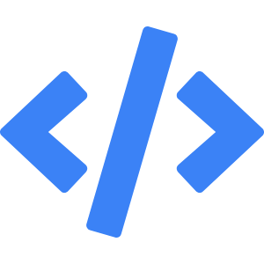



Basic Python Syntax
Foundations for Writing Python Code
Statement Structure
Python uses newlines to end statements and indentation to define blocks.
No Semicolons
Python eliminates the need for semicolons at the end of lines.
Indentation Rules
Proper indentation (usually 4 spaces) is crucial for block-level structuring.
Comments
Use '#' for single-line and triple quotes for multi-line comments.
Notes:
Before we dive into coding, it's essential to understand Python's basic syntax. Unlike many languages, Python emphasizes readability and simplicity. It uses newline characters to denote the end of a statement rather than semicolons. This makes your code cleaner and easier to follow.
Another major difference is Python’s use of indentation. Indentation is not just for style—it defines blocks of code. If the indentation is incorrect, your code won’t run. Most commonly, we use 4 spaces per indent level. Mastering this is key to avoiding syntax errors.
Finally, commenting is crucial. Single-line comments start with a '#', while multi-line comments are enclosed in triple quotes. Clear commenting helps you and others understand the intent behind your code—making collaboration easier and more effective.

Slide 8




Comments and Indentation
Clean Code Practices in Python
Single-Line Comments
Begin with '#' to add context or disable code.
Multi-Line Comments
Use triple quotes (''' or """) for longer notes or documentation.
Mandatory Indentation
Blocks like loops, conditionals, and functions rely on consistent indentation.
Style Guidelines
Follow PEP 8 for consistent formatting and better readability.
Notes:
Writing clean and readable code is fundamental in Python, and it starts with two elements: comments and indentation. Comments allow you to annotate your code, making it easier for others (and your future self) to understand what you were thinking.
For single-line comments, just use a hash symbol (#). For multi-line explanations, enclose your text in triple quotes. This is also useful for writing documentation strings (docstrings) inside functions or classes.
Perhaps the most unique aspect of Python is indentation. Unlike other languages where braces or keywords define blocks, Python uses white space. Misaligned indentation will cause syntax errors. Stick to 4 spaces, and use tools like linters to enforce PEP 8—the Python style guide.

Slide 9




Variables and Assignment
Storing and Managing Data in Python
Dynamic Typing
No need to declare variable types; Python assigns based on value.
Assignment Syntax
Use '=' to assign values to variables. Example: name = 'Alice'
Naming Conventions
Use lowercase letters and underscores (e.g., user_age) for readability.
Multiple Assignments
Assign multiple values in one line: x, y = 10, 20
Notes:
Variables are the foundation of any programming language. In Python, variables are dynamically typed, which means you don’t have to specify the data type during declaration. Python infers it automatically based on the value assigned.
To assign a value, you simply use the equals sign: `name = 'Alice'` or `age = 25`. Python uses what's called 'binding'—the name is bound to an object in memory. Also, Python supports multiple assignments in a single line, like `x, y = 5, 10`.
Naming variables clearly is also important. Use descriptive names in lowercase with underscores, following PEP 8 naming conventions. This not only improves readability but also minimizes bugs in complex codebases.

Slide 10
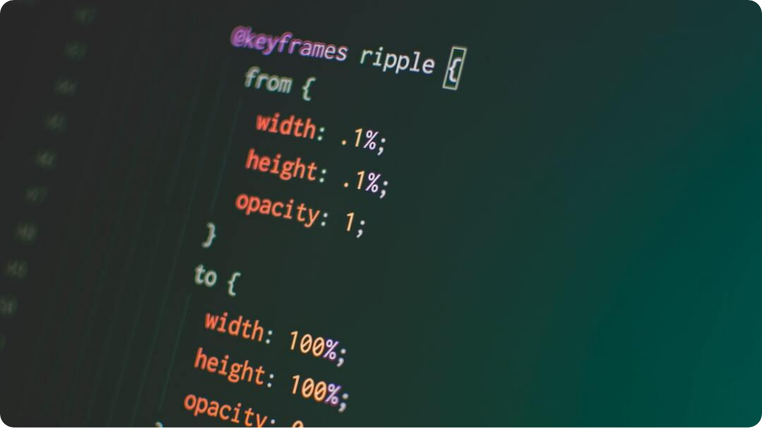
Data Types in Python
Understanding Core Data Types
Integers: Whole numbers without decimals. Example: 10, -3
Floats: Numbers with decimals. Example: 3.14, -0.001
Strings: Text data enclosed in quotes. Example: 'Hello'
Booleans: Logical values True or False, often used in conditions.
Photo by Pankaj Patel on Unsplash
Notes:
Python offers several core data types that form the basis of all programming tasks. The most common types are integers, floats, strings, and booleans.
Integers are used for whole numbers like 1, -100, or 42. Floats, on the other hand, represent real numbers with decimal points, such as 3.14 or -0.01. Understanding when to use each is essential for numerical operations.
Strings are sequences of characters, typically enclosed in single or double quotes. You’ll use them frequently for labeling, formatting output, and parsing text. Booleans—True and False—are key in logic and decision-making, especially when we explore conditions and loops later on.
These data types are automatically inferred by Python when you assign a value to a variable. You can always check a variable’s type using the built-in `type()` function.

Slide 11




Type Casting and Conversion
Switching Between Python Data Types
Implicit Conversion
Python automatically converts types during operations when safe.
Explicit Casting
Use int(), float(), str(), etc., to force type changes.
Common Errors
Casting incompatible types, like int('abc'), will raise errors.
Best Practices
Always validate data before casting, especially with user inputs.
Notes:
Type casting allows you to convert variables from one type to another. Python performs implicit conversion when it deems it safe—for instance, combining an int and float in an operation results in a float.
However, most of the time, you'll use explicit casting. This involves functions like `int()`, `float()`, `str()`, and `bool()` to convert values manually. It’s powerful, but you need to be careful—trying to convert 'abc' into an integer will trigger a runtime error.
Type validation is a best practice, especially when working with user inputs or external data. Using tools like `isinstance()` or try-except blocks will help prevent crashes and unexpected behavior during type conversion.

Slide 12



Input and Output Functions
Interacting with Users in Python
print() Function
Displays output to the console. Supports strings, variables, and expressions.
input() Function
Captures user input from the keyboard as a string.
Formatting Output
Use f-strings, % formatting, or .format() for customized output.
Type Handling
Always cast input to appropriate type (e.g., int(input()) for numbers).
Notes:
User interaction begins with two key functions in Python: `print()` and `input()`. The `print()` function is your go-to tool for displaying data, messages, and results to the console. It supports multiple data types and can format them in readable ways.
The `input()` function collects data typed by the user. It always returns a string, so type conversion is often necessary. For example, to collect a number, use `int(input("Enter a number: "))`. This ensures you're working with the right data type in your logic.
Python also supports several ways to format output. F-strings are the most modern and preferred method, offering clear syntax and flexibility. Understanding these tools allows for more engaging and dynamic programs.

Slide 13




Arithmetic and Logical Operators
Performing Calculations and Logic Checks
Arithmetic Operators
Includes +, -, *, /, %, **, and // for mathematical operations.
Comparison Operators
Compare values using ==, !=, >, <, >=, and <=.
Logical Operators
Use and, or, not to build compound logical expressions.
Practical Examples
Operators are used in loops, conditions, and expressions.
Notes:
In Python, operators are the building blocks of logic and computation. Arithmetic operators such as `+`, `-`, `*`, `/`, `%`, `**` (exponent), and `//` (floor division) are used to perform mathematical tasks across all numerical data types.
When you need to compare values, use comparison operators like `==`, `!=`, `>`, `<`, `>=`, and `<=`. These return boolean values—True or False—and are essential in control structures.
Logical operators (`and`, `or`, `not`) allow you to combine multiple conditions or negate a condition. They're commonly used in decision-making logic, loops, and validations.
Mastering these operators will allow you to build dynamic, responsive programs that can make decisions and perform complex calculations based on user input or data analysis.

Slide 14

Comparison Operators
Evaluating Conditions in Python
Equality & Inequality: Use == to test equality and != for inequality.
Greater/Less Than: >, <, >=, and <= compare numerical or lexicographical values.
Returns Boolean: Comparison operations return either True or False.
Use in Conditions: Essential in if statements and loops to control flow.
Photo by Zan on Unsplash
Notes:
Comparison operators are fundamental to making decisions in Python. They evaluate relationships between values and return a boolean outcome: either `True` or `False`. The most common operators include `==` (equals), `!=` (not equals), `>`, `<`, `>=`, and `<=`.
These are used to compare numbers, strings, and even other objects. For example, `5 > 3` returns `True`, while `'apple' == 'orange'` returns `False`. You’ll frequently use these within conditional statements like `if`, `elif`, and `while`.
Understanding these comparisons enables your programs to branch, repeat actions conditionally, and respond to inputs dynamically. They’re the logic gates of Python’s control flow.

Slide 15



Conditional Statements
Controlling Program Flow with if, elif, else
if Statement
Executes a block of code if the condition is true.
elif Clause
Tests additional conditions if the previous ones are false.
else Clause
Provides a fallback when no conditions are met.
Nesting
Conditions can be nested for complex decision logic.
Notes:
Conditional statements let you control the flow of execution in your Python programs. The `if` statement runs a block of code only if a given condition is true. You can follow it with `elif` clauses to test multiple conditions, and an `else` clause to handle all remaining cases.
Here's a basic example:
```python
x = 10
if x > 0:
print("Positive")
elif x == 0:
print("Zero")
else:
print("Negative")
```
Conditions can also be nested, letting you build sophisticated logic. Just remember that clear and readable conditions make your code easier to maintain and debug.

Slide 16
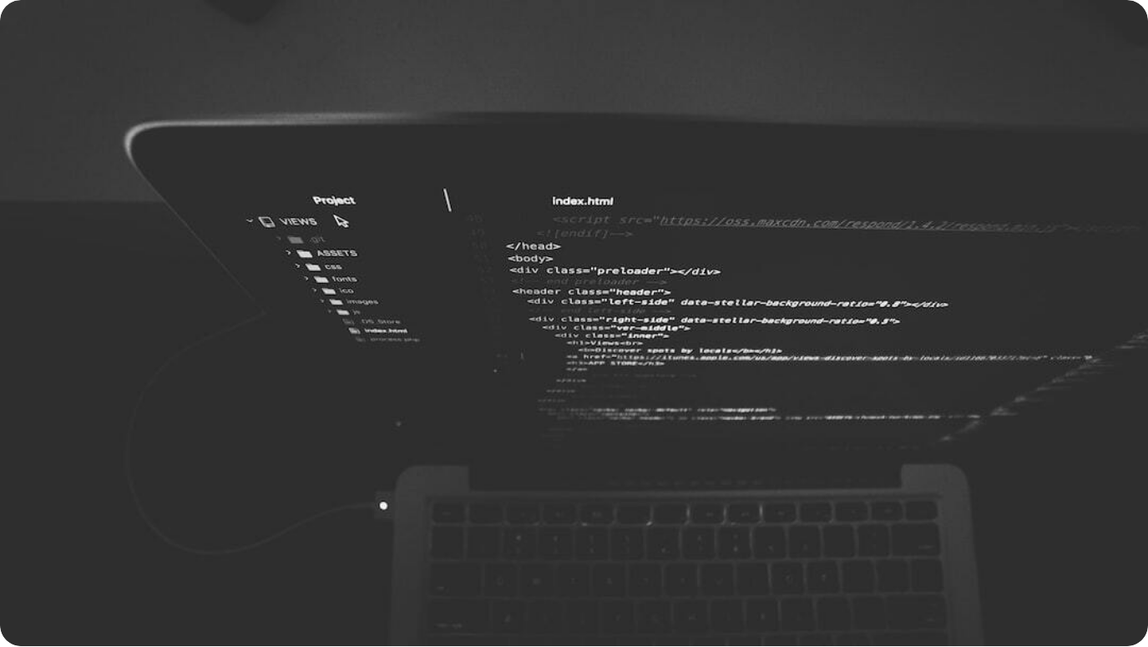
Nested Conditions
Building Multi-Level Logic in Python
Definition: An if or else block containing another if-else structure.
Use Case: Useful for multi-step decisions requiring layered logic.
Syntax Caution: Requires precise indentation to avoid logic errors.
Avoid Overuse: Refactor into functions or logical operators for readability.
Photo by Nate Grant on Unsplash
Notes:
Nested conditions occur when one conditional block is placed inside another. This structure is useful for multi-level decisions, like validating input and checking ranges or categories within categories.
Example:
```python
x = 20
if x > 10:
if x < 30:
print("Between 10 and 30")
```
While powerful, deeply nested code can become hard to read. Always use clear indentation and consider refactoring complex logic into functions or combining checks with logical operators. Readability and maintainability are just as important as correctness in Python.

Slide 17



Introduction to Loops
Repetitive Execution in Python
For Loop
Iterates over a sequence like a list, tuple, or string.
While Loop
Repeats while a condition is true; useful for indeterminate repetition.
Loop Control
Use break, continue, and pass to manage loop flow.
Use Cases
Loops are ideal for automation, data processing, and pattern generation.
Notes:
Loops allow you to repeat a block of code multiple times, which is crucial for automation and data processing. Python offers two primary types: `for` loops and `while` loops.
The `for` loop is used to iterate over a sequence such as a list, string, or range. It’s especially useful when the number of iterations is known. The `while` loop continues executing as long as a condition is true, making it suitable for cases where the end is unpredictable.
You can control loop behavior with `break` (exit loop), `continue` (skip iteration), and `pass` (placeholder). Mastering loops is a fundamental part of writing efficient Python code.

Slide 18

Practice Exercise: Conditional Calculator
Hands-on with if, elif, else
Objective: Create a CLI calculator that performs +, -, *, / based on user input.
Input Flow: Accept two numbers and an operator from the user.
Conditional Logic: Use if-elif-else to determine the operation.
Output Result: Print the result or an error for invalid input.
Photo by Adi Goldstein on Unsplash
Notes:
Let’s apply what we’ve learned through a mini-project: building a command-line calculator. This exercise reinforces conditional logic, input/output, and type casting.
The program will prompt the user for two numbers and an arithmetic operator. Based on the input operator (`+`, `-`, `*`, `/`), the calculator will compute and display the result.
This simple project encourages problem-solving using basic Python tools. It also introduces error handling and validation concepts that we will explore in greater detail later.

Slide 19

Mini Project Overview
CLI Calculator Design
Goal: Build a Python program that performs basic arithmetic operations.
CLI Interface: Text-based interaction using input() and print().
Logic: Use conditionals to map input operator to corresponding operation.
Error Handling: Account for invalid input and division by zero.
Photo by Blake Connally on Unsplash
Notes:
This mini-project aims to consolidate your learning into a tangible output: a command-line interface calculator. This small program is a stepping stone toward real-world applications.
You’ll collect two numbers and an operator from the user. The logic will evaluate which operation to perform using conditionals. We'll use Python's basic input/output and arithmetic tools to complete this task.
Handling edge cases—like invalid input or division by zero—is an important part of building resilient software. This exercise not only reinforces programming concepts but also encourages good software habits from the start.

Slide 20


Step-by-Step Implementation
Building the CLI Calculator in Python
Input Collection
Prompt user for two numbers and an arithmetic operator.
Data Conversion
Convert string inputs to appropriate numeric types using int() or float().
Conditional Logic
Use if-elif-else to evaluate the selected operation.
Display Output
Print the computed result or error messages.
Notes:
Let’s break the CLI calculator down into clear implementation steps. First, collect input from the user: two numbers and an operator. This is your primary interface, and it uses Python’s `input()` function.
Next, convert the string inputs to numbers using `int()` or `float()`. This is essential for performing arithmetic operations. Then, structure the logic using if-elif-else statements to match the operator to the corresponding action.
Finally, print the result back to the user using `print()`. Always test the calculator for edge cases such as invalid input or division by zero. These steps collectively ensure the project is functional and beginner-friendly.

Slide 21
Code Review and Output
Interpreting CLI Calculator Results
Code Walkthrough: Review Python code line-by-line for clarity and logic.
Output Scenarios: Explore expected results for each arithmetic operation.
Error Handling: Handle invalid operators and division by zero gracefully.
Testing Tips: Run test cases for various inputs to ensure robustness.
Photo by Ilija Boshkov on Unsplash
Notes:
Now that your CLI calculator is implemented, it’s time to evaluate it. We’ll walk through the code line-by-line to understand how each part contributes to functionality.
From collecting input and casting types, to conditionally executing the correct operation, every step is intentional. You’ll also see examples of both correct outputs and error messages—especially when dividing by zero or entering an invalid operator.
Testing is critical. Try different combinations, such as 10 ÷ 2, or entering letters instead of numbers, to verify how your calculator responds. These tests improve code quality and reliability, preparing you for more advanced projects.

Slide 22
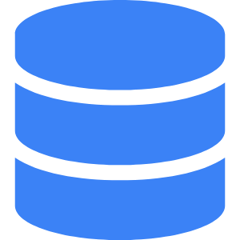

Key Takeaways and Summary
Recap of Python Fundamentals Learned Today
Python Syntax
Clear, indentation-based structure supports readability and simplicity.
Data Types and Variables
Integers, floats, strings, booleans form the core of data handling.
Control Flow
Conditional statements and loops provide logic and automation.
Hands-on Practice
Built a CLI calculator using all the core concepts.
Notes:
Let’s summarize what we’ve covered today in your first Python session. You’ve learned Python’s unique syntax, built around readability and indentation. This structural clarity is one of Python’s most celebrated features.
We explored the main data types—integers, floats, strings, booleans—and how to assign and convert between them. We saw how control structures like `if`, `else`, and loops help automate logic and decision-making in your programs.
Most importantly, you applied these skills in a mini-project, building a working calculator that accepts user input and performs arithmetic operations. This hands-on experience cements your understanding and sets the stage for more advanced topics ahead.

Slide 23

Q&A and Homework
Wrap-up and Continued Practice
Open Q&A: Address questions about today's topics or the calculator project.
Homework Task: Rebuild the calculator to include exponent and modulus operations.
Explore Further: Research Python built-in functions like abs(), round(), and len().
Next Session Prep: Review loops and write a program that prints the multiplication table.
Photo by Mari Helin on Unsplash
Notes:
We’re wrapping up the day with a quick Q&A session—feel free to ask about anything we covered, whether it's Python syntax, loops, or the calculator project.
For homework, you'll enhance your calculator by adding exponent (`**`) and modulus (`%`) capabilities. This challenge reinforces your logic skills and introduces new operators.
To expand your Python toolbox, explore built-in functions like `abs()`, `round()`, and `len()`. Finally, as a prep for tomorrow’s session, try writing a program that prints multiplication tables using a `for` loop. This exercise will ease your transition into working with repetitive tasks and nested logic.

